Slide 1
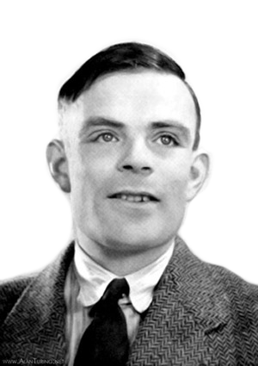
The enigma game
By Murtaza Yaqoob and Steven Eisinger

Slide 2
Some history and inspiration…

Slide 3

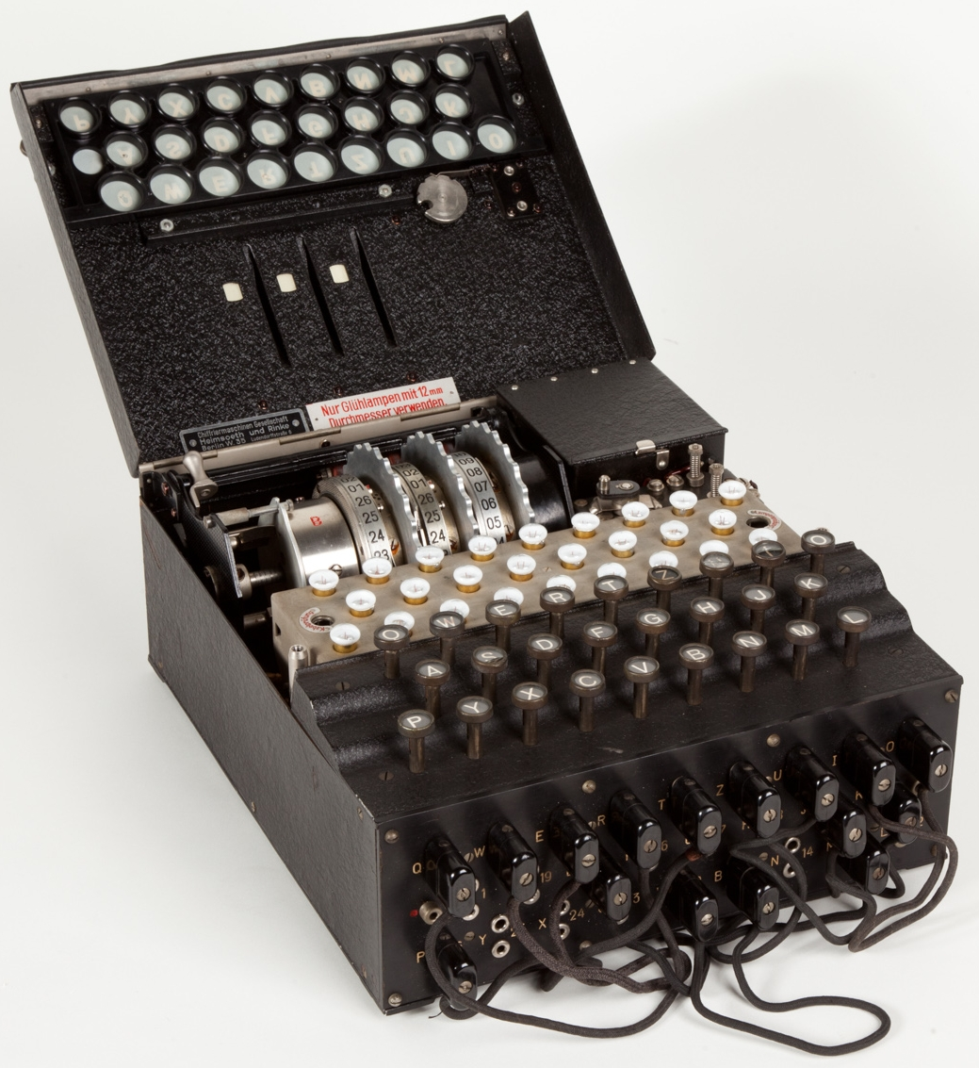
The Enigma Machine
The Enigma Machine is a cypher machine invented by Arthur Scherbius in 1918.
In 1926, the German Navy began using a modified version of this machine to encrypt their communications.
During World War II, British codebreakers at Bletchley Park were tasked with cracking the Enigma code to decrypt Axis communications and gather crucial intellegence

Slide 4
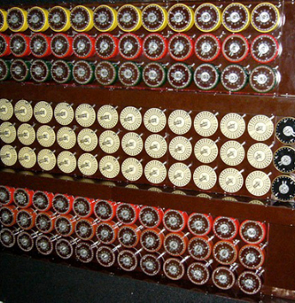
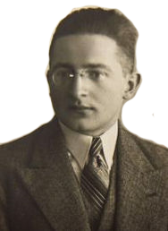
The bombe!
Many attempts were made by Allied forces to decipher the Enigma code.
The Polish were able to decrypt Enigma messages manually by 1932, but it took a long time. In 1938, the Polish mathematician Marian Rejewski invented the bomba kryptologiczna to brute force the solution.
After the Germans made their Enigma more complicated in 1939, Alan Turing invented the British bombe to decipher it in 1940.

Slide 5
The enigma game chip

Slide 6
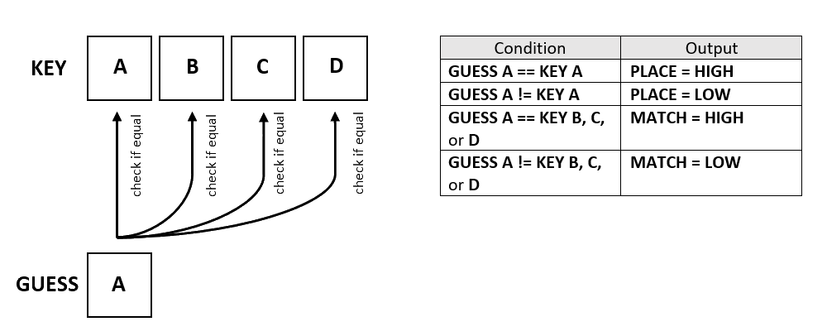
The basic design

Slide 7
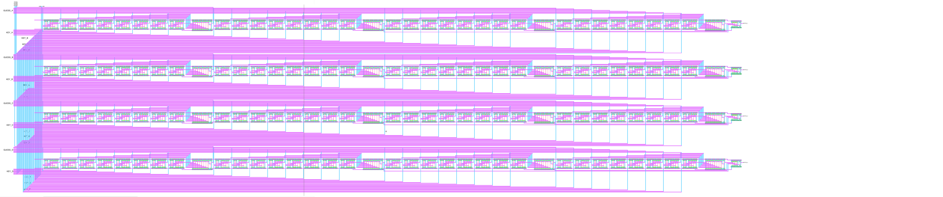
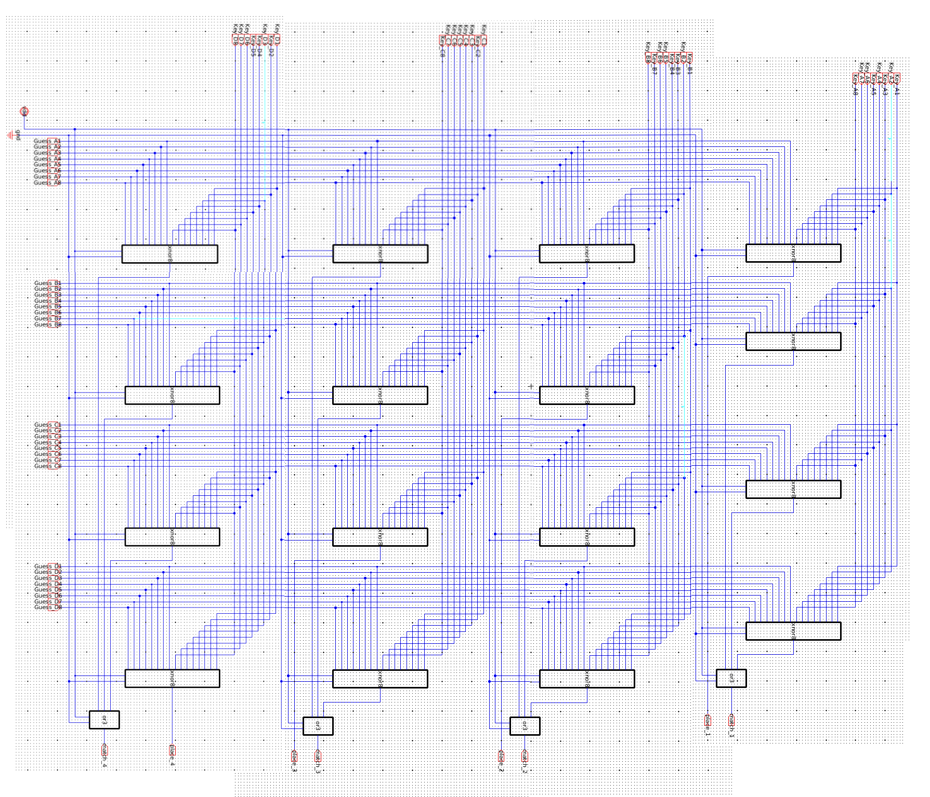
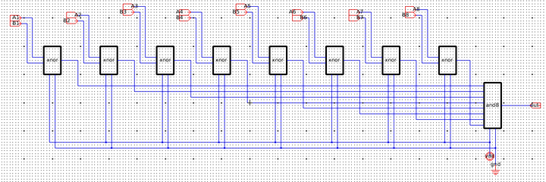
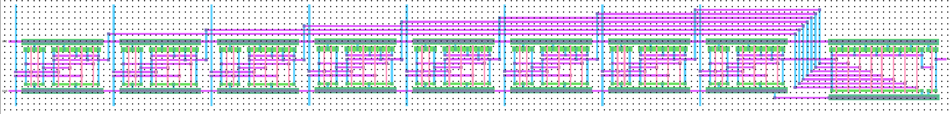
KEY D
KEY C
KEY B
KEY A
GUESS A
16 8-bit XNORs
GUESS B
GUESS C
4 3-bit ORs
GUESS D
MATCH 1
MATCH 4
PLACE 4
MATCH 3
MATCH 2
PLACE 1
PLACE 3
PLACE 2

Slide 8
Some stats
1,856 transistors
About 2.4mm x 0.6mm in size
23.9 mW power consumption

Slide 9
DEMO time!

Slide 10

How to play
Players agree on a turn limit, who will create the key, and who will make guesses.
Player 1 inputs a ‘key’ consisting of 4 unique characters.
Player 2 inputs a guess as to what the key is.
The ‘Enigma Game’ chip lets Player 2 know whether the characters they guessed exist somewhere in the key and if the character is in the correct location.
Player 2 continues to guess and receive a result from the chip until they guess the correct key, resulting in a win, or the predetermined turn limit is reached, resulting in a loss.
● ○○
◍
1235?
1234
****

